Slide 1

MAX PLANCK INSTITUTE FOR HEART AND LUNG RESEARCH
Bioinformatics Core Unit

Slide 2
Introduction
Terms and methodology this pipeline is based on.

Slide 3
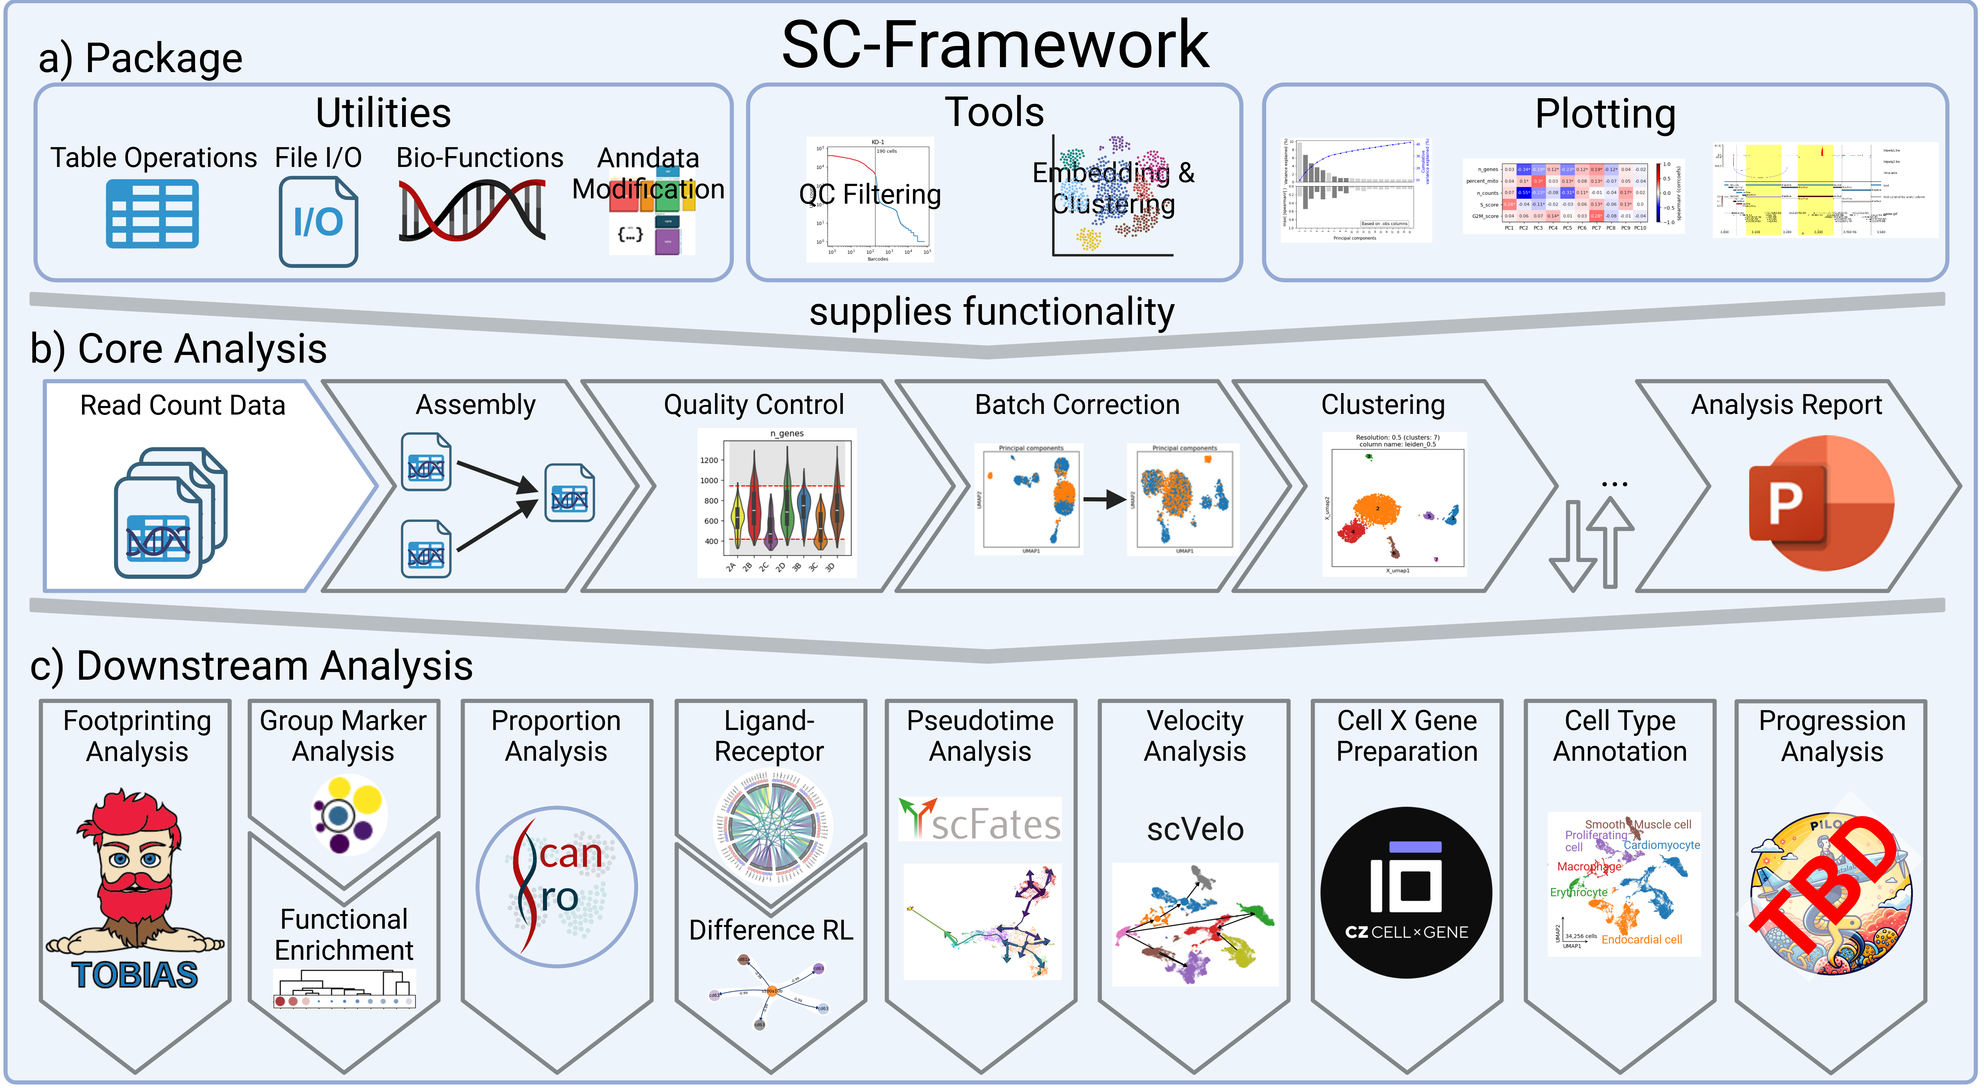
Overview
Manual: https://loosolab.pages.gwdg.de/software/sc_framework/

Slide 4
Overview
Core analysis
Downstream analysis

Slide 5
Terms and Algorithms
Observation (obs)
In scRNA-seq data an observation refers to a cell identified by a barcode unique in the dataset.
Variable (var)
A variable refers to a gene. Both var and obs can have additional metadata, e.g. cell types (obs) or “is mitochondrial” (var).
Matrix
The analysis is based on an expression matrix (obs x var) that contains the raw RNA counts for each cell over each gene.
Principle Component Analysis (PCA)
The PCA reduces the high-dimensional data by summarizing similar behaving genes into principle components (PCs). PCs that explain little of the dataset variance or PCs that correlate with technical factors are considered noise and removed.
t-distributed stochastic neighbor embedding (t-SNE)
The t-SNE further reduces the dimensions (PCs) from the PCA to a low-dimensional output (usually 2D).
More information on t-SNE
Uniform Manifold Approximation and Projection (UMAP)
UMAP takes the PCs from the PCA and reduces them into a low-dimensional, 2D or 3D, representation. It does so, by constructing a high-dimensional graph and optimizing a low-dimensional analogue to be as similar as possible. Both UMAP and t-SNE are mostly equivalent techniques to visualize high-dimensional data. They are robust, meaning they will provide highly similar results. Thus, we provide either UMAP or t-SNE.
More information on UMAP

Slide 6
Terms and Algorithms
Batch correction
Batch effects are variances in the data that are not intended by the experimental design (e.g. technical variance). They can be introduced through various sources. For example, sequencing samples at different timepoints may introduce batch effects. As batch effects could interfere with downstream analysis they are typically removed. However, it can be challenging to identify and correct for batch effects as this is highly dependent on the experimental setup of the dataset. For optimal results an experiment should be designed in a way that each condition is present in at least two different batches.
Local Inverse Simpson's Index (LISI)
The LISI measures the strength of a batch effect based on the heterogeneity in each group. Meaning, a well-mixed dataset, without any batch effect will get a high score of up to the number of batches in the dataset.
Clustering
The clustering, typically done using the leiden algorithm, sorts the cells of a dataset into groups based on their expression similarity. The resulting clusters are commonly thought to be cell types and annotated in the following steps.
Quantile rank differences
The difference in rank a data point has between two groups. The two groups are divided into parts of equal probability (quantiles) and the rank of the data point, i.e. which quantile the data point belongs to, are compared between the two groups. The score ranges from -1 to 1. A score <0 means the data point is ranked higher in the first group, while >0 means it is ranked higher in the second group. The distance from 0 means how big the difference between the two ranks is.

Slide 7
Methods

